Slide 1
Model Deployment

Slide 2
What is Model Deployment?
The process of integrating a trained ML model into a production environment where it can make predictions on new data.
Goal: Convert a research model → scalable production service.
Types of Deployment:
  Batch Inference: Periodic predictions on stored data.
  Real-Time Inference: Predictions via APIs on live data.

Slide 3
Steps in Building an ML Model
Data Collection and Cleaning
Feature Engineering
Model Training and Evaluation
Model Selection
Model Saving and Versioning
Deployment for Real-World Use

Slide 4
Introduction to MLFlow
MLFlow is an open-source platform for managing the entire machine learning lifecycle.
Developed by Databricks.
Supports all major ML frameworks: Scikit-learn, PyTorch, TensorFlow, XGBoost, etc.
Focuses on experiment tracking, reproducibility, and deployment.

Slide 5
Why MLFlow?
Reproducible experiments
Centralized model registry
Simplified deployment
Framework-agnostic (works with any ML framework)
Integrates with CI/CD and cloud platforms

Slide 6
Components of MLFlow
MLFlow Tracking: Logs parameters, metrics, and artifacts.
MLFlow Projects: Packages code for reproducible runs.
MLFlow Models: Defines a standard format for packaging ML models.
MLFlow Model Registry: Manages versioning, approval, and lifecycle of models.

Slide 7
MLFlow Architecture
User Interface (UI): For tracking experiments and comparing runs.
Tracking Server: Stores metrics, parameters, and artifacts.
Artifact Store: Saves model files and datasets.
Model Registry: Manages model versions and states (staging/production).

Slide 8
What is MLOps
MLOps (Machine Learning Operations) is a set of practices, tools, and processes that automate and streamline the end-to-end machine learning lifecycle.
Goal: Bridge the gap between data science and IT operations to ensure scalable, reliable, and efficient deployment of ML models.
Analogy: MLOps = DevOps + Machine Learning

Slide 9
Why Traditional DevOps is Not Enough
In ML, data changes as frequently as code.
Model accuracy depends on both data and algorithms.
Deployment needs continuous monitoring for data drift.
Retraining pipelines must be automated.
Hence, a specialized process — MLOps — is needed.

Slide 10
Core Components of MLOps
Version Control: Code, data, and model versioning (e.g., Git, DVC).
Continuous Integration (CI): Automate model testing and validation.
Continuous Deployment (CD): Deploy models quickly and reliably.
Monitoring: Track model performance and drift.
Automation: Create reusable, reproducible ML pipelines.

Slide 11
MLOps Architecture
Data Pipeline: Collect and preprocess new data.
Training Pipeline: Train and evaluate model.
Deployment Pipeline: Move model into production environment.
Monitoring & Feedback: Track performance, detect drift, trigger retraining.

Slide 12
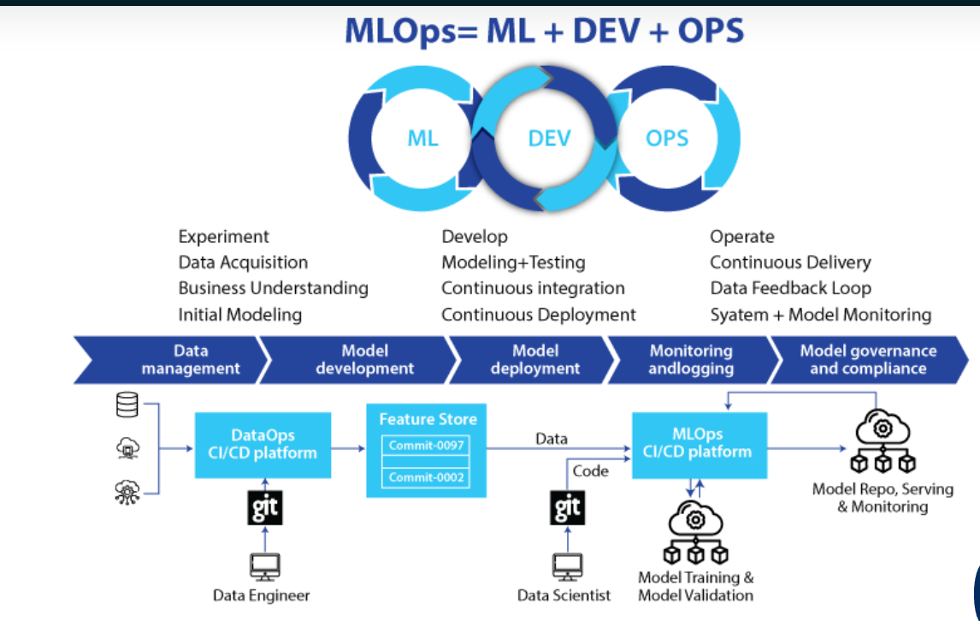

Slide 13
Popular MLOps architecture patterns
There are several popular architecture patterns in MLOps:
1. Lambda architecture: The Lambda architecture combines batch and real-time processing to handle large-scale data ingestion, processing and analytics. It allows for both historical and real-time data analysis, making it suitable for time-sensitive ML applications.

Slide 14
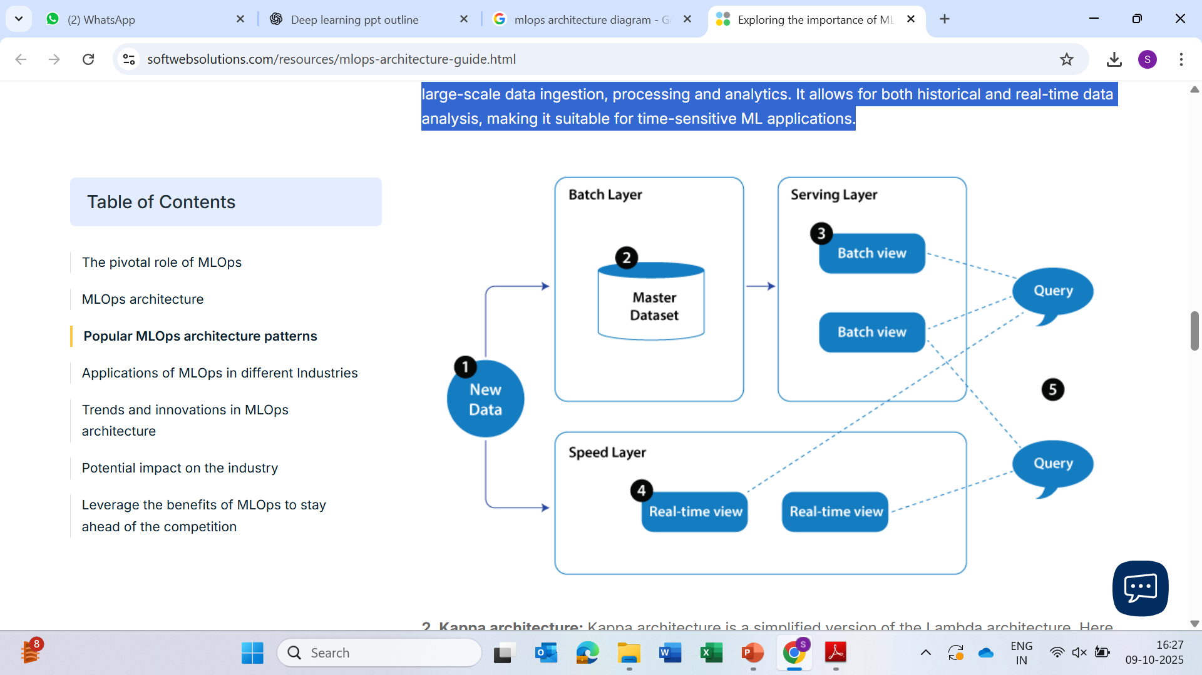
Lambda architecture

Slide 15
2. Kappa architecture:
Kappa architecture is a simplified version of the Lambda architecture. Here real-time streaming data is directly fed into the processing pipeline, eliminating the need for separate batch and real-time layers.
It offers lower latency and simpler processing but sacrifices some capabilities of the Lambda architecture.

Slide 16
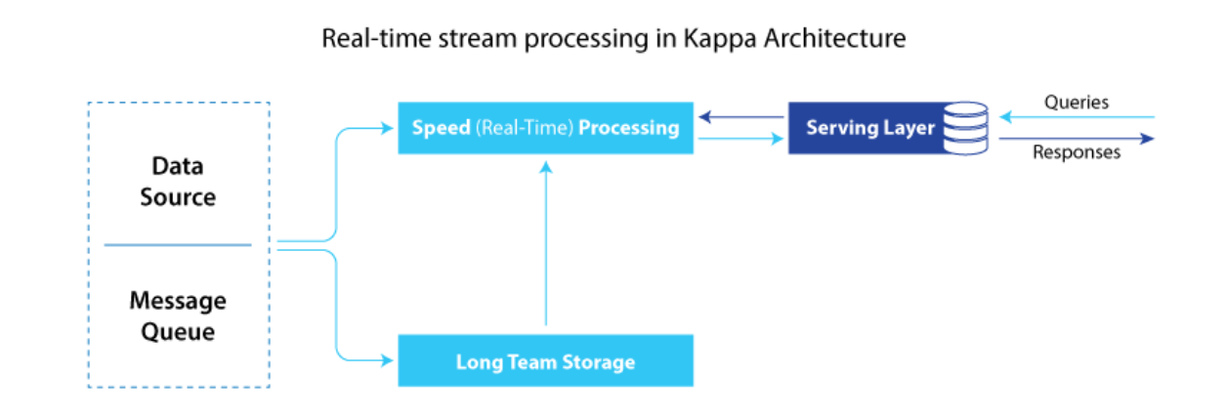
Kappa architecture:

Slide 17
Key Stages in MLOps Workflow
Data Management – Data versioning, cleaning, and validation.
Model Development – Experiment tracking and hyperparameter tuning.
Model Validation – Check for performance, bias, and fairness.
Deployment – Package and deploy using Docker/Kubernetes.
Monitoring & Retraining – Detect drift and automatically retrain model.

Slide 18
The Need for MLOps
MLOps is essential because:
Reproducibility: Ensures consistent results across environments.
Scalability: Supports large-scale data and models.
Collaboration: Enables data scientists and engineers to work seamlessly.
Automation: Reduces manual work in deployment and retraining.
Monitoring: Continuously tracks model health and accuracy.

Slide 19
Benefits of MLOps
Faster model development and deployment
Improved accuracy and stability
Reduced operational cost and downtime
Traceable experiments and better governance
Scalable architecture suitable for enterprise ML

Slide 20
What is ML Production Infrastructure?
The system architecture that supports deployment, scaling, and monitoring of ML models.
Enables continuous integration, continuous deployment (CI/CD), and version control for models.
Bridges the gap between data science and operations teams.

Slide 21
Key Components
Data Pipeline – Ingestion, preprocessing, and transformation.
Model Training Environment – Compute resources (GPU/TPU), frameworks (TensorFlow, PyTorch).
Model Registry – Stores model versions and metadata.
Model Serving Layer – API or microservices for real-time predictions.
Monitoring & Logging – Tracks performance, latency, and drift.

Slide 22
Data Infrastructure
Data is the foundation of production ML.
Components:
Data storage (Databases, Data Lakes).
ETL (Extract, Transform, Load) systems.
Stream processing (Kafka, Spark).
Ensures data consistency and availability for retraining and inference.

Slide 23
Model Deployment Infrastructure
Methods for serving models:
Batch Inference: Large-scale predictions on scheduled intervals.
Online Inference: Real-time API calls.
Deployment Tools:
Docker, Kubernetes, TensorFlow Serving, TorchServe, MLFlow Models.

Slide 24
Model Registry & Versioning
Centralized repository for managing:
Model versions.
Metadata (training data, parameters).
Approval and release workflow.
Tools: MLFlow Model Registry, SageMaker Model Registry.

Slide 25
Monitoring and Logging
Monitor:
Model performance drift.
Data distribution changes.
Resource utilization (CPU/GPU).
Logging tools: Prometheus, Grafana, ELK Stack.
Enables proactive maintenance and retraining.

Slide 26
Infrastructure for Scalability
Scale across multiple environments:
Cloud Platforms: AWS, GCP, Azure.
Containerization: Docker for portability.
Orchestration: Kubernetes for auto-scaling and load balancing.
Supports both horizontal and vertical scaling.

Slide 27
Continuous Integration & Continuous Deployment (CI/CD)
Automates the ML lifecycle:
Code testing.
Model validation.
Automated deployment pipelines.
Tools: Jenkins, GitHub Actions, MLFlow, Kubeflow Pipelines.

Slide 28
Infrastructure Challenges
Handling large-scale data efficiently.
Maintaining model performance over time.
Ensuring reproducibility and compliance.
Managing costs and computational resources.

Slide 29
Tools and Technologies
Data Layer: Apache Kafka, Airflow, Spark
Training Layer: TensorFlow, PyTorch
Model Management: MLFlow, DVC
Deployment: Docker, Kubernetes
Monitoring: Prometheus, Grafana

Slide 30
Summary
ML Production Infrastructure ensures end-to-end reliability.
Enables automation, scalability, and continuous improvement.
Essential for sustainable AI systems in real-world environments.

